Slide 1
Shell Bootcamp 2024 3 Reflections for Week 2
Anshul Sathe
Date : 30-Aug-2024

Slide 2

About Me
“There’s no job too immense when you got confidence.”
- Elvis Presley

Slide 3

My learnings from this week!

Slide 4
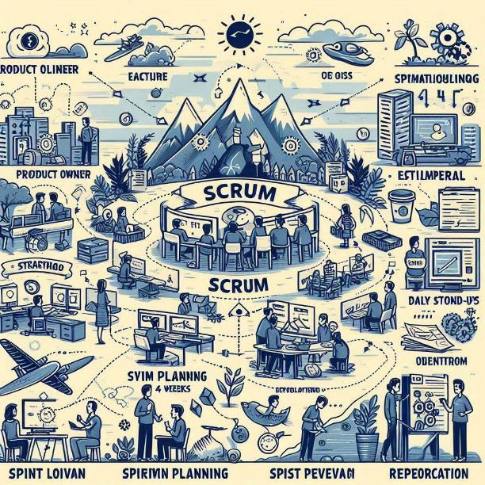
Learning 1 | My takeaways
Story Pointing: Estimation
Definitions (DoR & DoD): Criteria & Completion
Scrum Board & Progress: Visualization & Advancement
Environments (Scrum, Development, etc.): Frameworks & Stages
Workflows (Agile & Scrum): Iterative & Sprints

Slide 5
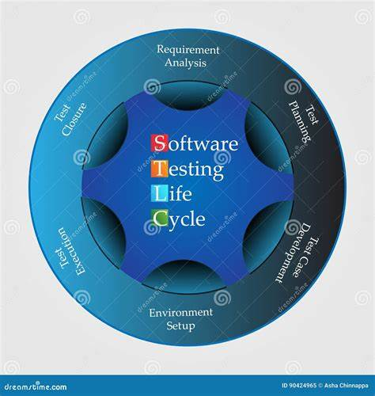
Learning 2 | My takeaways
Kanban: Visualization, WIP Limits, Flow, Improvement
Estimation: Work, Effort, Time
Charts: Burndown, Burnup, Velocity
Software Testing: SDLC, System, Integration, Unit, Coding
STLC: Strategy, Plan, Design, Environment, Execution, Reporting, Closure
Testing Types: Static, Dynamic, Functional, Non-functional, White-box, Black-box, Automated, Manual

Slide 6
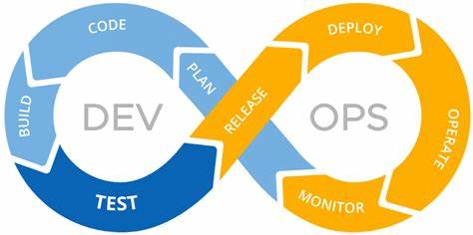
Learning 3 | My takeaways
Kanban & Agile: Visualization, WIP Limits, Flow, Improvement, Estimation (Work, Effort, Time)
Software Testing: SDLC, STLC, Testing Types (Static, Dynamic, Functional, Non-functional, White-box, Black-box, Automated, Manual)
DevOps: Lifecycle, Principles, Benefits, Tools, CI/CD, GitHub Actions
Databases: RDBMS, NoSQL, Data Warehouse, Graph Database, OLTP
Cloud Computing: Elasticity, Access, On-demand, Cost, Benefits (Cost Savings, Scalability, Security, Speed), SaaS, PaaS, IaaS
Infrastructure Components: Servers, Storage, Networking, Virtualization, Load Balancing, Security

Slide 7

Relevance of learnings for my organization

Slide 8

Learning 1 | Relevance for Shell
These topics have helped me understand how workflow in a team is maintained and how we are supposed to communicate with stakeholders to ensure that the product we deliver is very relevant to the stakeholders and the public as well. Efficiency and effort are both optimized this way.

Slide 9

Learning 2 | Relevance for Shell
We learnt a lot about the technical side of the job. Software testing and training is an integral part of whatever we do at Shell. Coding and system also teaches a lot about how to implement this knowledge in real life.

Slide 10
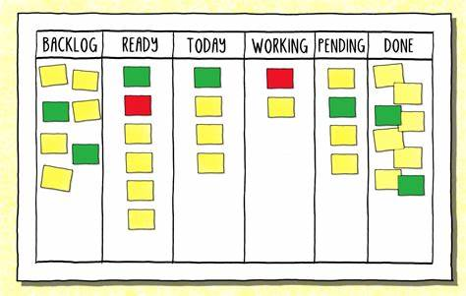
Learning 3 | Relevance for Shell
Kanban & Agile streamline workflow with visualization and WIP limits. Software Testing covers SDLC, STLC, and various testing types. DevOps integrates development and operations with CI/CD. Databases include RDBMS, NoSQL, and more. Cloud Computing offers flexible resources and benefits. Infrastructure Components form the backbone of IT systems.

Slide 11

Challenges in implementing learning

Slide 12

Challenge faced while implementing Learning 1
No problem so far. Implemented importance of Scrum and workflows in practical life.

Slide 13

Challenge faced while implementing Learning 2
No problem so far. Learnt the importance of testing, coding and system integration.

Slide 14

Challenge faced while implementing Learning 3
Dev Ops, DBMS and Cloud concepts were thoroughly collaborated and revised.

Slide 15

Action Plan

Slide 16
My Action Plan for this Week
Actions
Timeline
Status
Implement these skill in practically in real life.
Working on DBMS and cloud implementation problems.
Goals achieved.

Slide 17

Learning is also Fun!

Slide 18

Learning is also Fun!
Learning can be fun! Kanban & Agile make work smoother. Software Testing ensures everything works. DevOps blends development and operations seamlessly. Databases store all our data. Cloud Computing offers flexible, cost-effective resources. Infrastructure Components like servers and networking keep everything running smoothly. Enjoy the tech journey!

Slide 19

Summary
We learnt the importance of Agile workflows, Scrum, CI/CD concepts.
Cloud, DBMS and Dev-Ops will also be used in real life scenarios
We will start with IDSO specific training from next week.

Slide 20
Thank You

